Slide 1


Slide 2

Comprehensives 50%
Sessional 1 15%
Sessions 2 15%
Business plan Report 10 %
Presentation 10%

Slide 3


Slide 4

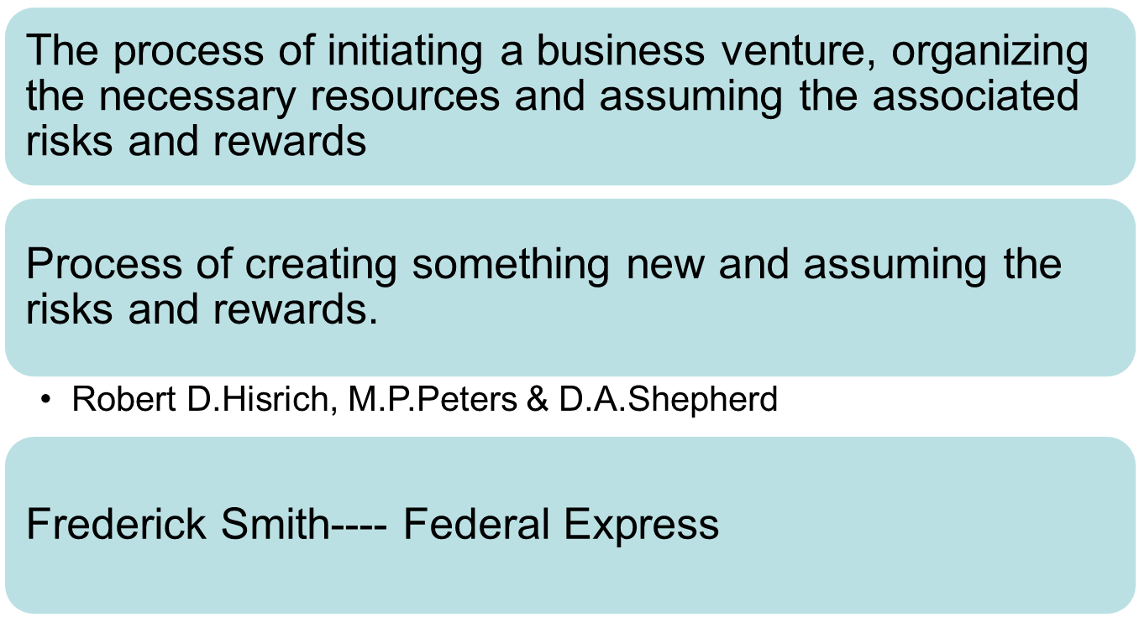

Slide 5


Fedex

Slide 6


